Slide 1
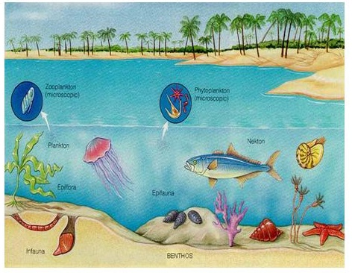
Energetics of Marine Ecosystems Part I
Section 3

Slide 2
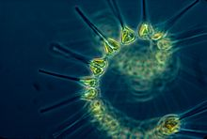
Photosynthesis
Plants capturing sunlight
Makes energy available to the food chain
Source of energy for nearly all life on Earth
Green plants, including phytoplankton in aquatic food chains, capture light energy and use this to synthesize organic substances, including carbohydrates
Converts light energy to chemical energy
glucose
Notes:
Organisms need energy for growth, reproduction, and metabolic processes
No organism can create energy-producers obtain it from other sources. This can happen in shallow water by algae/phytoplankton or in deeper water by chemosynthetic bacteria

Slide 3
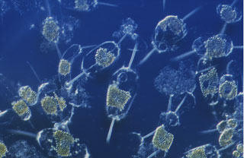
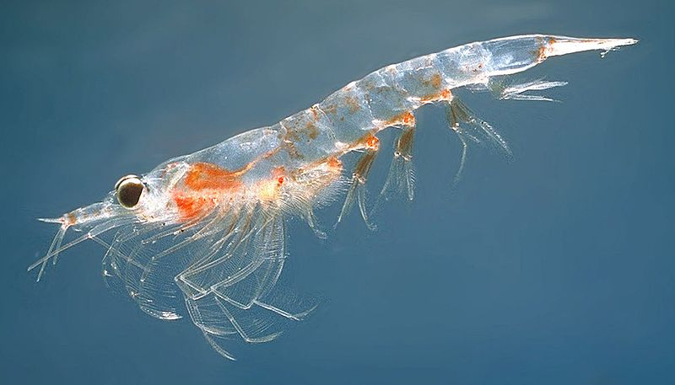
Phyto and Zoo Plankton
Greek
Phyto = plant
Zoo = animal
Planktos = drifter; wanderer
Phyto – autotrophs
Zoo – heterotrophs – cannot produce own energy
Cnidarians – jellyfish
Crustaceans - krill

Slide 4
Chlorophyll
Green pigment found in algae and plants that allows them to absorb energy from light
Greek
Chloros – green
Phyllon – leaf

Slide 5
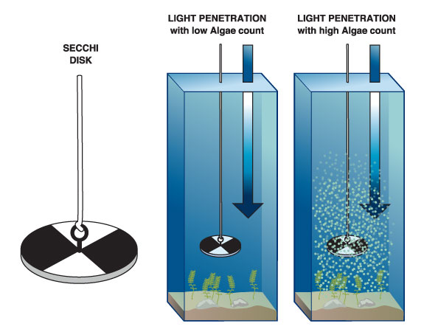
Secchi Disc
Used to measure light penetration
Black and white disc

Slide 6
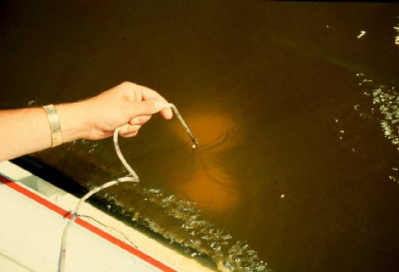
Secchi Disc
Disc is lowered into water until no longer visible – depth recorded
Then slowly raised until seen again – depth recorded
Mean of these two depths = transparency of water
Turbidity = clarity

Slide 7
Review: Marine Food Web
What is the primary source of energy for this food web?
From the food web, write a complete food chain that has the least number of trophic levels.
Explain what the arrows between each organism represent.

Slide 8
Answers
(i) Sun/light; [1]
(ii) phytoplankton – krill – minke whales/penguins - killer whales [1]
(iii) transfer of energy from each trophic level;
transfer of biomass from each trophic level; [2]
Energy flow song—ParrMr
http://youtu.be/JSfezoPjUk4

Slide 9
Deep Ocean
Not much light penetrates deeper than 200m = 600 ft
Photosynthesis not possible
Producers (autotrophs = self feeders) here must find substances by other means

Slide 10
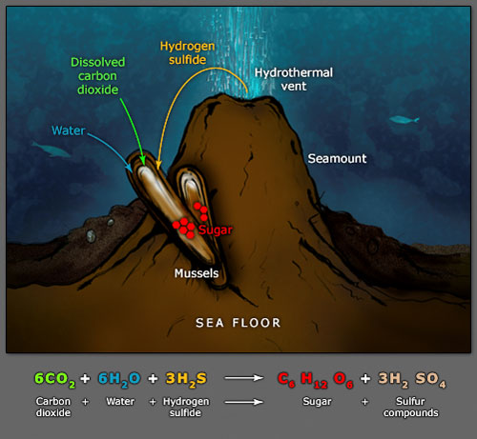
Chemosynthesis
captures the chemical energy of dissolved minerals
chemosynthetic bacteria at hydrothermal vents make energy available to the food chain in the deep sea
Only some species of bacteria derive energy from the oxidation of inorganic substances (like hydrogen sulfide), and use this energy to synthesize organic compounds

Slide 11
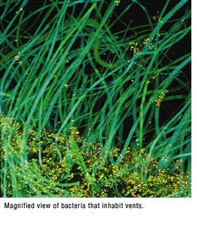
Hydrothermal Vents
Fluid emerging from hydrothermal vents is rich in hydrogen sulfide and other gases.
Chemosynthetic bacteria oxidize H₂S and fix CO₂ to form organic substances
Provide food source for animals in the hydrothermal vent ecosystem
Example: tube worm, giant clams

Slide 12
Riftia
Symbiotic relationship with chemosynthetic bacteria
Provide nutrients TO Riftia

Slide 13
Comparison: Chemo vs Photo

Slide 14
Productivity
The rate of accumulation/production of biomass/energy
Biomass = the mass of living biological organisms in an ecosystem at a given time
Measured in terms of energy capture (mass of carbon incorporated) per unit area (or per unit volume in aquatic ecosystems) per year(unit time)
Almost all ecosystems = green plants are primary producers
Consumers depend directly or indirectly on the energy captured by primary producers
Productivity of an ecosystem affects all trophic levels

Slide 15
Productivity
When conditions are favorable for photosynthesis, the productivity of the ecosystem tends to be relatively high
Example: tropical rain forests, algal beds and reefs

